Slide 1

NETRESCUE – SELF HEALING SOFTWARE NETWORKS
Mini-project presentation
Computer Networks Laboratory (CSE20110)
Department of Computer Engineering and Technology
Manjiri Sakore – 1262242414 Aashnaa Panda– 1262241937
Rishita Kumar –1262242408 Tanushree Doddamani–1262241836
Group: 14 Panel K Batch 02
Faculty: Dr. Uma Pujeri
Academic Year: 2026–2027
Presentation date: 22/10/2026
Computer Networks Laboratory CSE20110
15 seconds
Notes:
Suggested time: 15 seconds. Replace all bracketed placeholders and prompts with your own project details. Keep explanations brief. Total time across slides 1–7 is 5 minutes, including the demonstration. Slide 8 is for reference during questions. Logo source: https://mitwpu.edu.in/uploads/images/MIT-WPU-logo-1.webp. Introduce only the title and team; do not read every PRN.

Slide 2


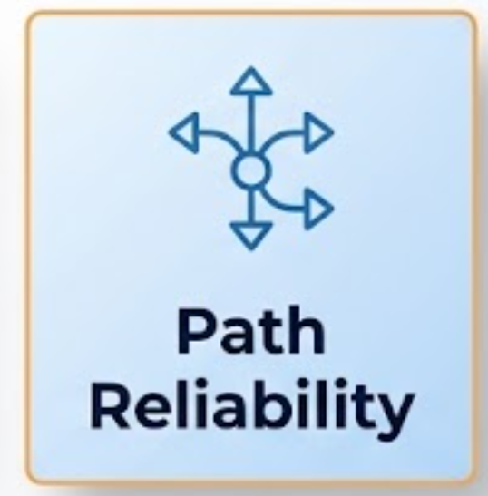
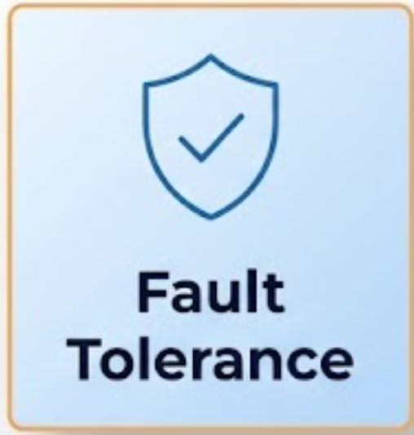
Problem and Objectives
Problem
NetRescue addresses network failures, packet loss, delays, and unreliable file transfers through failure recovery, multipath transfer, and diagnostics.
It targets network engineers, IT administrators, researchers, and students.
Objectives
Measure failure detection and recovery time using hysteresis-based thresholds.
Verify file-transfer completeness and integrity using chunk tracking and SHA-256 hashes.
Evaluate network latency, packet loss, and scheduler performance using real diagnostics and controlled simulations.
Computer Networks Laboratory CSE20110
40 seconds
Notes:
Suggested time: 40 seconds. Replace all bracketed placeholders and prompts with your own project details. Keep explanations brief. Total time across slides 1–7 is 5 minutes, including the demonstration. Slide 8 is for reference during questions.

Slide 3









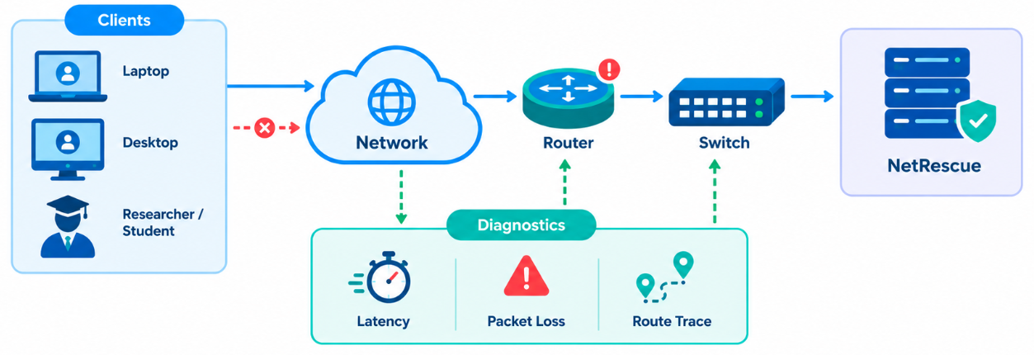




Proposed Design and Tools
Tools
Category | Details
Protocols | HTTP/HTTPS for API communication; ICMP for ping and latency checks; DNS for hostname resolution; TCP concepts for reliable transfer.
Addressing | Localhost: 127.0.0.1; Backend: port 8000; Frontend: Vite development port (e.g., 3002). Subnet and host addressing depend on the tested network.
Architecture
Computer Networks Laboratory CSE20110
45 seconds
Notes:
Suggested time: 45 seconds. Replace all bracketed placeholders and prompts with your own project details. Keep explanations brief. Total time across slides 1–7 is 5 minutes, including the demonstration. Slide 8 is for reference during questions. Explain the diagram and only the most relevant design decisions. Use an actual project diagram with readable labels.

Slide 4
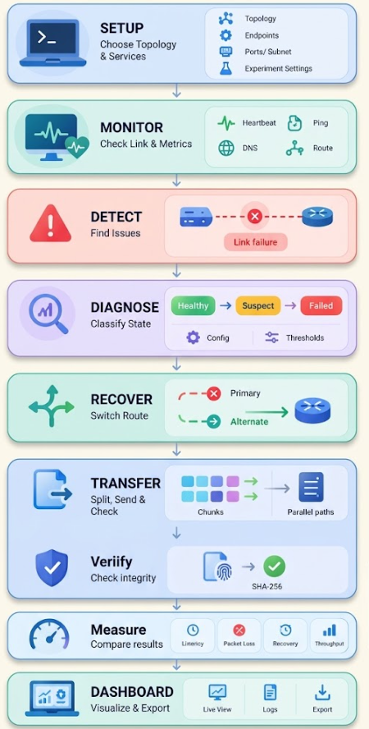
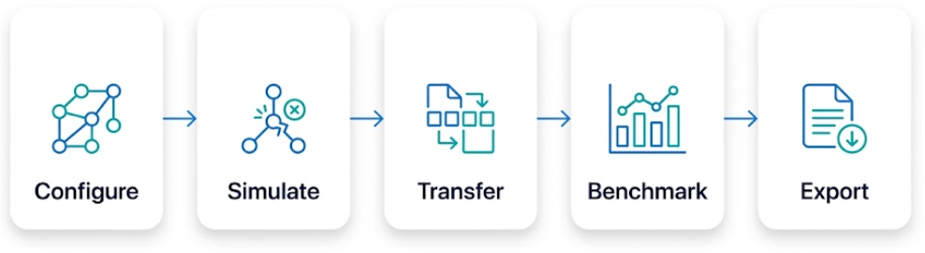
Implementation and Working
Workflow
Key configuration: F_thresh = 3, R_thresh = 5, N = 5, use_ewma = false.
Implementation
Troubleshooting
Tackled It
Configure Network Modules.
Set Recovery Thresholds
Configure Transfer Policies
Detect Link Failures
Check Network Connectivity
Validate Recovery Results
Connectivity Diagnostics
Hysteresis-Based Recovery
SHA-256 Verification
Working
Computer Networks Laboratory CSE20110
55 seconds
Notes:
Suggested time: 55 seconds. Replace all bracketed placeholders and prompts with your own project details. Keep explanations brief. Total time across slides 1–7 is 5 minutes, including the demonstration. Slide 8 is for reference during questions.

Slide 5
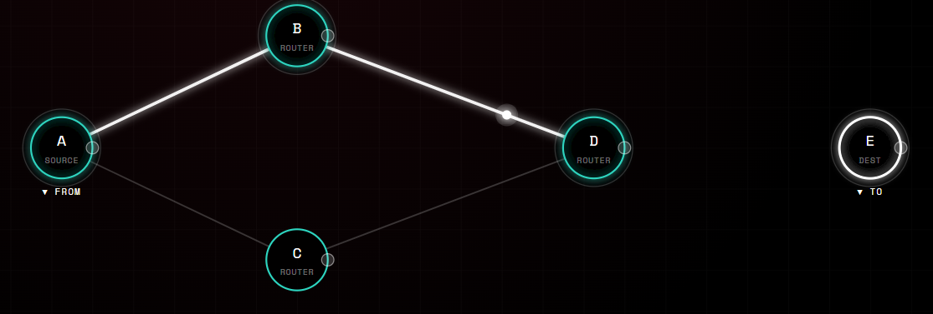
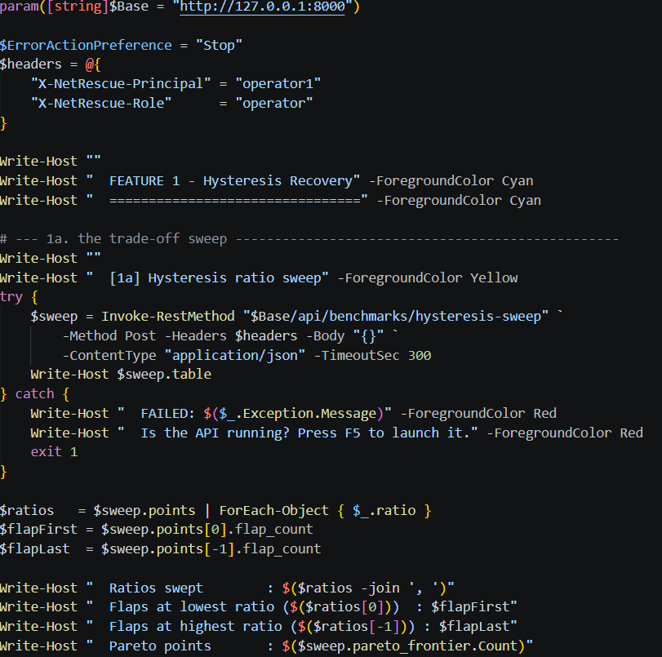

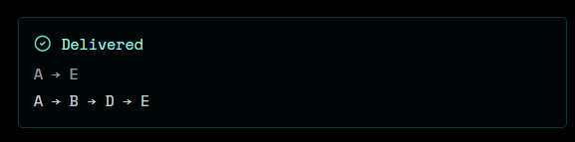
Testing and Results
Hysteresis-Based Recovery
Code
Test:
Simulate link failures and recoveries using configured thresholds.
Observed:
Objectives Achieved:
Failure detection and recovery time evaluation.
Computer Networks Laboratory CSE20110
50 seconds
Notes:
Suggested time: 50 seconds. Replace all bracketed placeholders and prompts with your own project details. Keep explanations brief. Total time across slides 1–7 is 5 minutes, including the demonstration. Slide 8 is for reference during questions. Show actual evidence. Explain the output and mention any failed or partial tests. Do not invent performance figures.

Slide 6
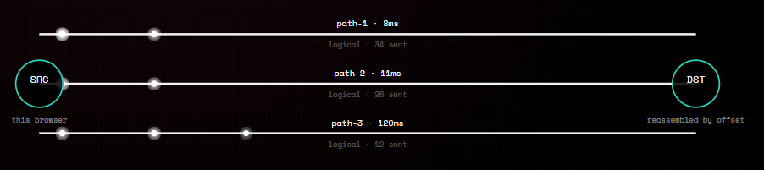
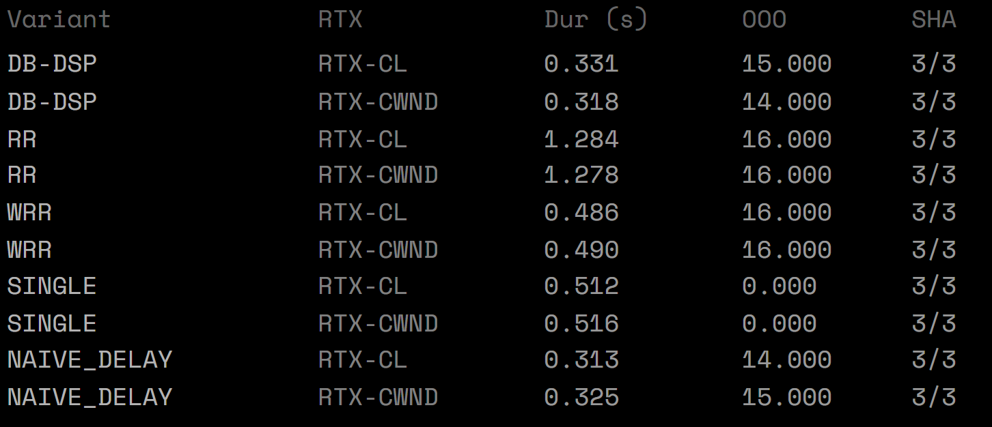
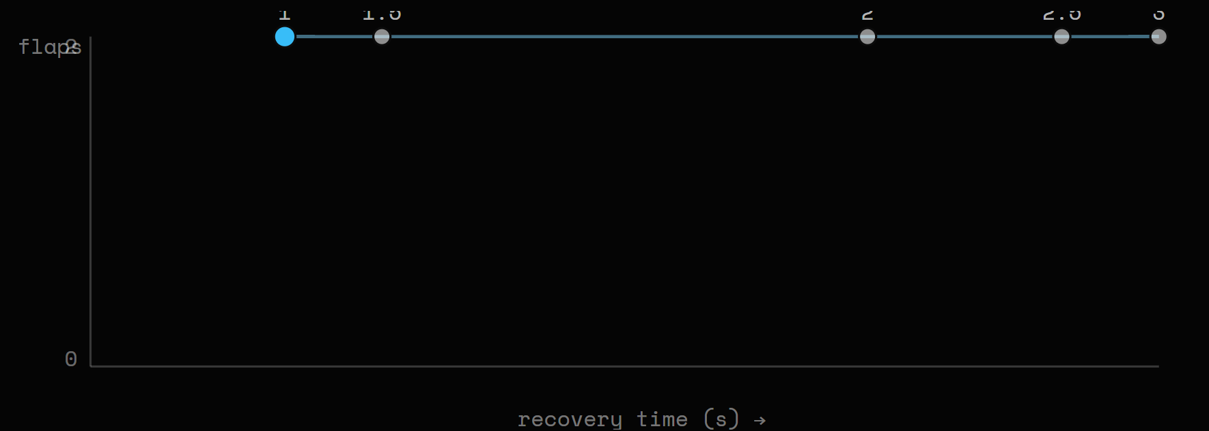
Working Demonstration
Function to demonstrate
We Demonstrate hysteresis-based network recovery, multipath file transfer with SHA-256 verification, and network diagnostics with performance benchmarking.
Multipath Transfer Lab
Network Diagnostics
Path
Output
Computer Networks Laboratory CSE20110
65 seconds
Notes:
Suggested time: 65 seconds. Replace all bracketed placeholders and prompts with your own project details. Keep explanations brief. Total time across slides 1–7 is 5 minutes, including the demonstration. Slide 8 is for reference during questions. Prepare the project before the timer starts. Keep the demo to about one minute. Keep a screenshot or short recording ready as a backup, and identify it as recorded evidence if used.

Slide 7
Conclusion and Contributions
Outcome
Reliable Recovery & Transfer
Application Network Fault Diagnosis
Limitation Simulated Logical Paths
Future Scope Adaptive Path Scheduling
Team Contributions
Manjiri Sakore — Feature 1 & 2 Implementation, Technical Architecture
Rishita Kumar — Feature 3 Implementation, Research & Ideation
Aashnaa Panda — Frontend Development, Research, PPT Design & Presentation
Tanushree Doddamani — Database Management, Testing, Documentation Writing
AI Tools Used
ChatGPT — Planning and documentation
Claude — Code generation and implementation
Perplexity AI — Research paper discovery
Google Gemini — Concept exploration and image
Computer Networks Laboratory CSE20110
30 seconds
Notes:
Suggested time: 30 seconds. Replace all bracketed placeholders and prompts with your own project details. Keep explanations brief. Total time across slides 1–7 is 5 minutes, including the demonstration. Slide 8 is for reference during questions.

Slide 8
References
[1] “On-demand scheduling for concurrent multipath transfer using the Stream Control Transmission Protocol (SCTP),” Journal of Network and Computer Applications, 2015. [Online].
Available: https://www.sciencedirect.com/science/article/abs/pii/S108480451400215X
[2] “On the impact of routing matrix inconsistencies on statistical path monitoring in overlay networks,” 2009. [Online]. Available: https://www.sciencedirect.com/science/article/pii/S108480451400215X?via%3Dihub
[3] A. Jurgelionis, J. P. Laulajainen, M. Hirvonen, and A. I. Wang, “An Empirical Study of NetEm Network Emulation Functionalities,” in Proc. 20th Int. Conf. Computer Communications and Networks (ICCCN), 2011, pp. 1–6, doi: 10.1109/ICCCN.2011.6005933.
Computer Networks Laboratory CSE20110
Backup slide
Notes:
Suggested time: Backup slide. Replace all bracketed placeholders and prompts with your own project details. Keep explanations brief. Total time across slides 1–7 is 5 minutes, including the demonstration. Slide 8 is for reference during questions.

